Slide 1
Security Scan for OpenStack
Demo 3
23 February 2018
Clara De Paolis
Dilip Makwana
Hao Wu
Chi Zhang

Slide 2
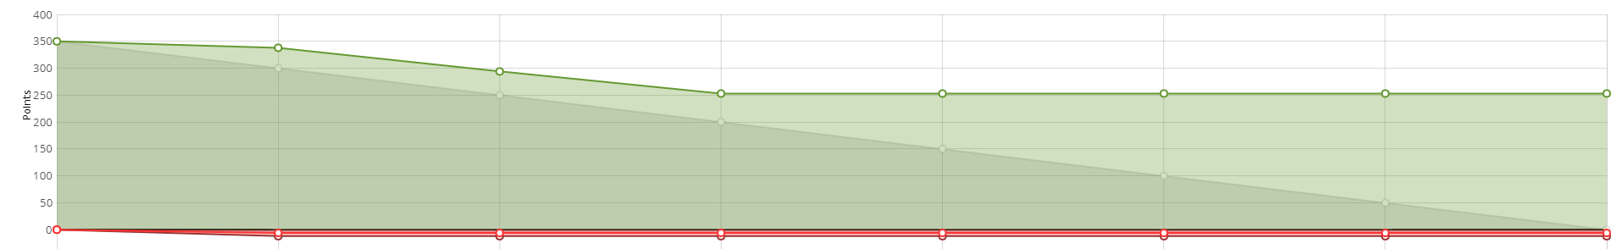
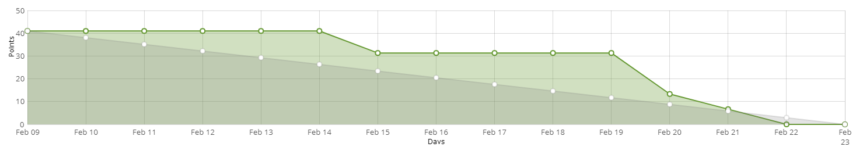
Progress Since Last Demo
Explore vulnerability scanning tools and choose one or more to use
Install and run vminspect on linux & windows qcow2 images on MOC
Understand vminspect results and how to expand them
Design decisions:
Who will be users of the project? A component of trilio rather than a common platform
Can backup images be made live? No -> use vminspect
When to scan, on-demand or event-driven? Two use cases, but both On-demand
How to scale up, containers or processes? Not clear, need to benchmark
Notes:
Hao

Slide 3
Vulnerability scanning tools
 | Scan w/o making live | Open source | Can use multiple vulnerability database | Description
vminspect (vulnscan) | ✔ | ✔ | ✔ | Tool uses libguestfs to read snapshot and queries CVE - Common Vulnerabilities and Exposures for results
Nessus | ✘ | ✘ | ✘ | A vulnerability scanner that perform scanning on active systems
OpenVAS | ✘ | ✔ | ✘ | Open source fork of Nessus
Seccubus | ✘ | ✔ | ✔ | Used to reduce the analysis time for subsequent scans of the same infrastructure by only reporting delta findings
Notes:
Chi / Hao

Slide 4
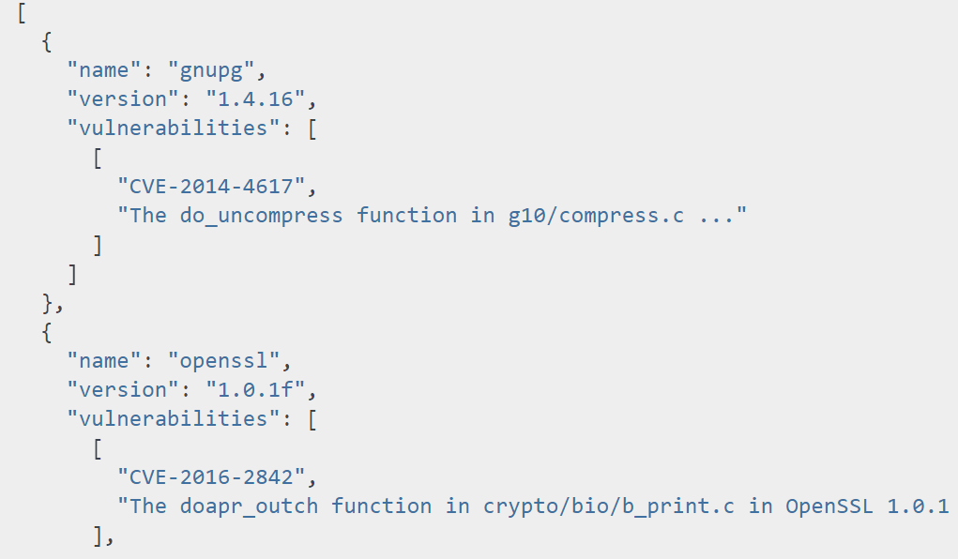
Vulnerability results
vminspect vulnscan: searches CVE database for vulnerabilities in installed
applications
Notes:
Clara

Slide 5
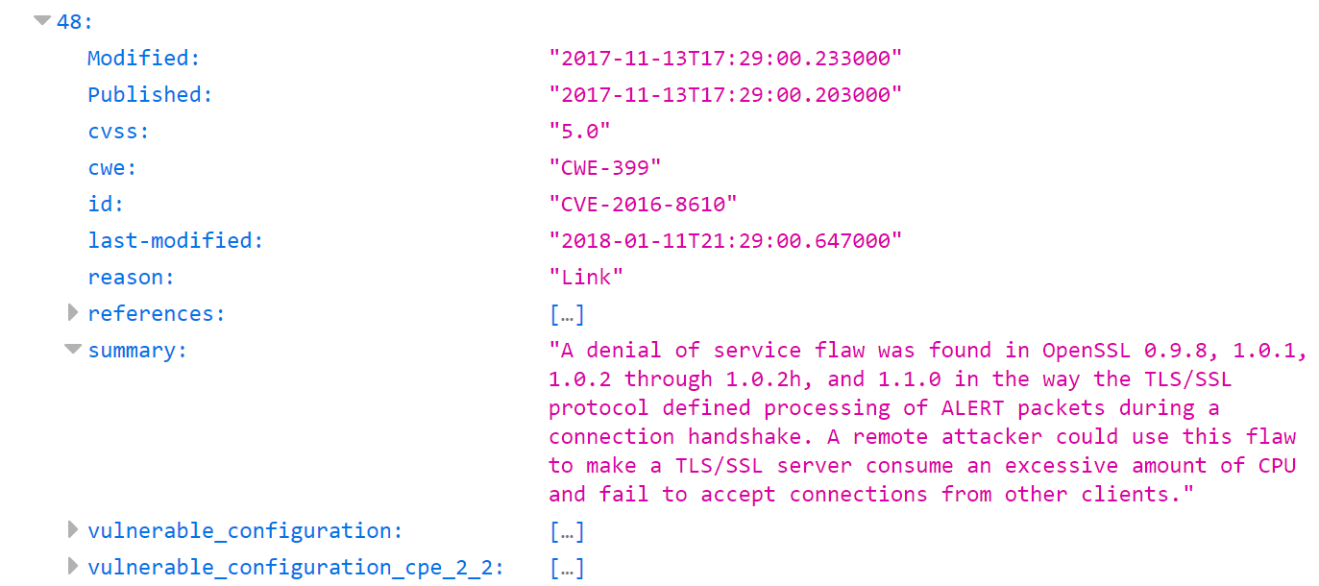
Vulnerability results
vminspect vulnscan: searches CVE database for vulnerabilities in installed
applications
Notes:
Clara

Slide 6
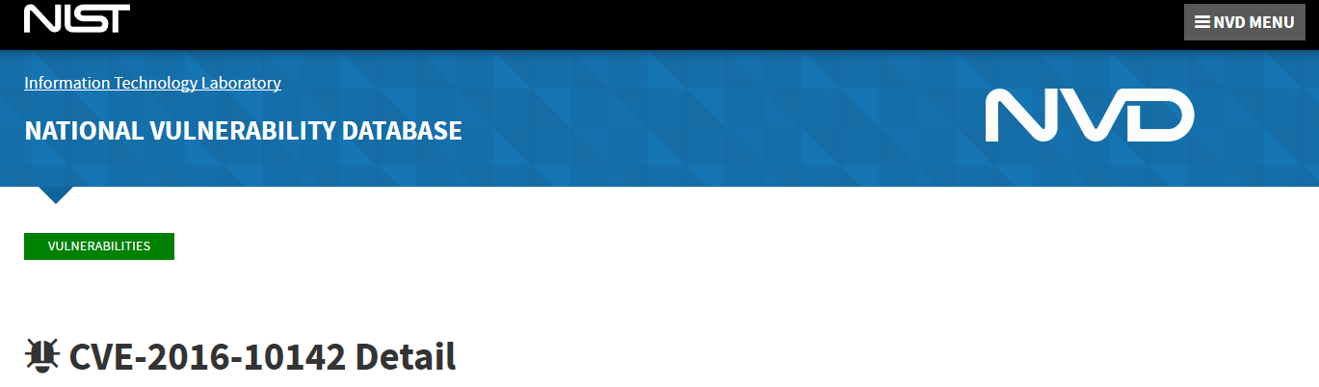
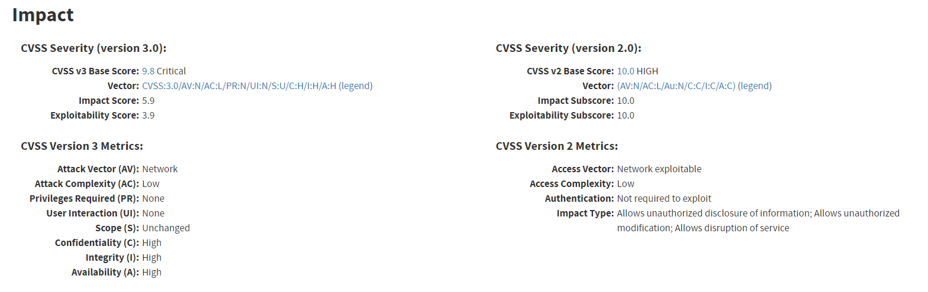
Vulnerability results
Notes:
Clara

Slide 7
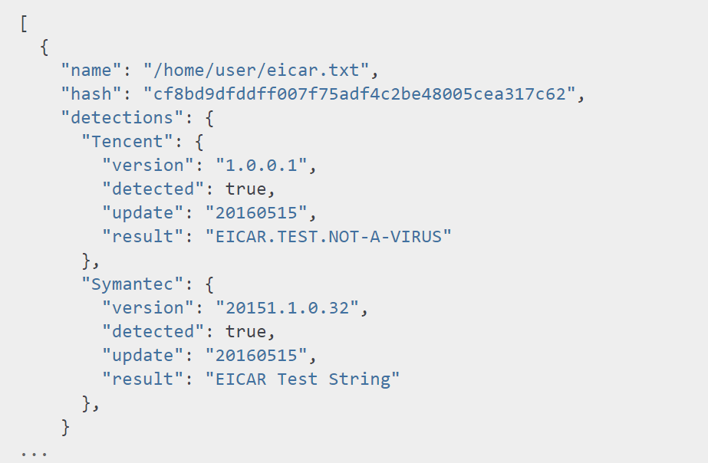
Vulnerability results: VirusTotal scan
vminspect vtscan: scan files for malware, searches via VirusTotal.com’s API
Notes:
Hao
Current state:
Problem facing
Have to upload to the website to perform the virus scan
Speed issue
Is inefficient to scan every single file in a system
We’re able to filter by directory, and file names

Slide 8
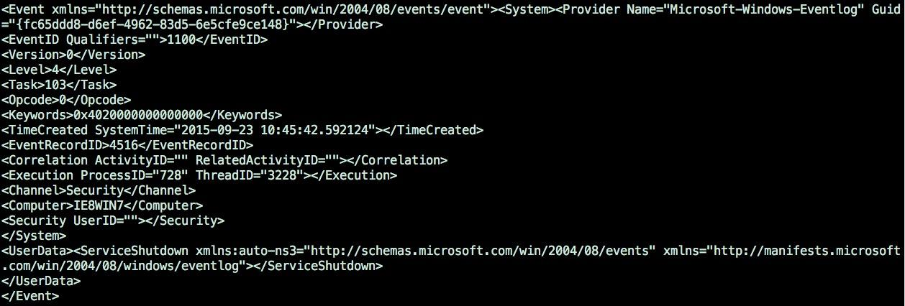
Vulnerability results: Windows Event Log
Windows only feature
How can we make the information more useful?
Notes:
Hao

Slide 9
vulnscan time benchmark
Without concurrent requests to CVE DB API
-> 14.30s user 4.78s system 3% cpu 9:57.65 total
With concurrent requests to CVE DB API
-> 13.34s user 4.55s system 30% cpu 58.492 total
Notes:
Dilip

Slide 10
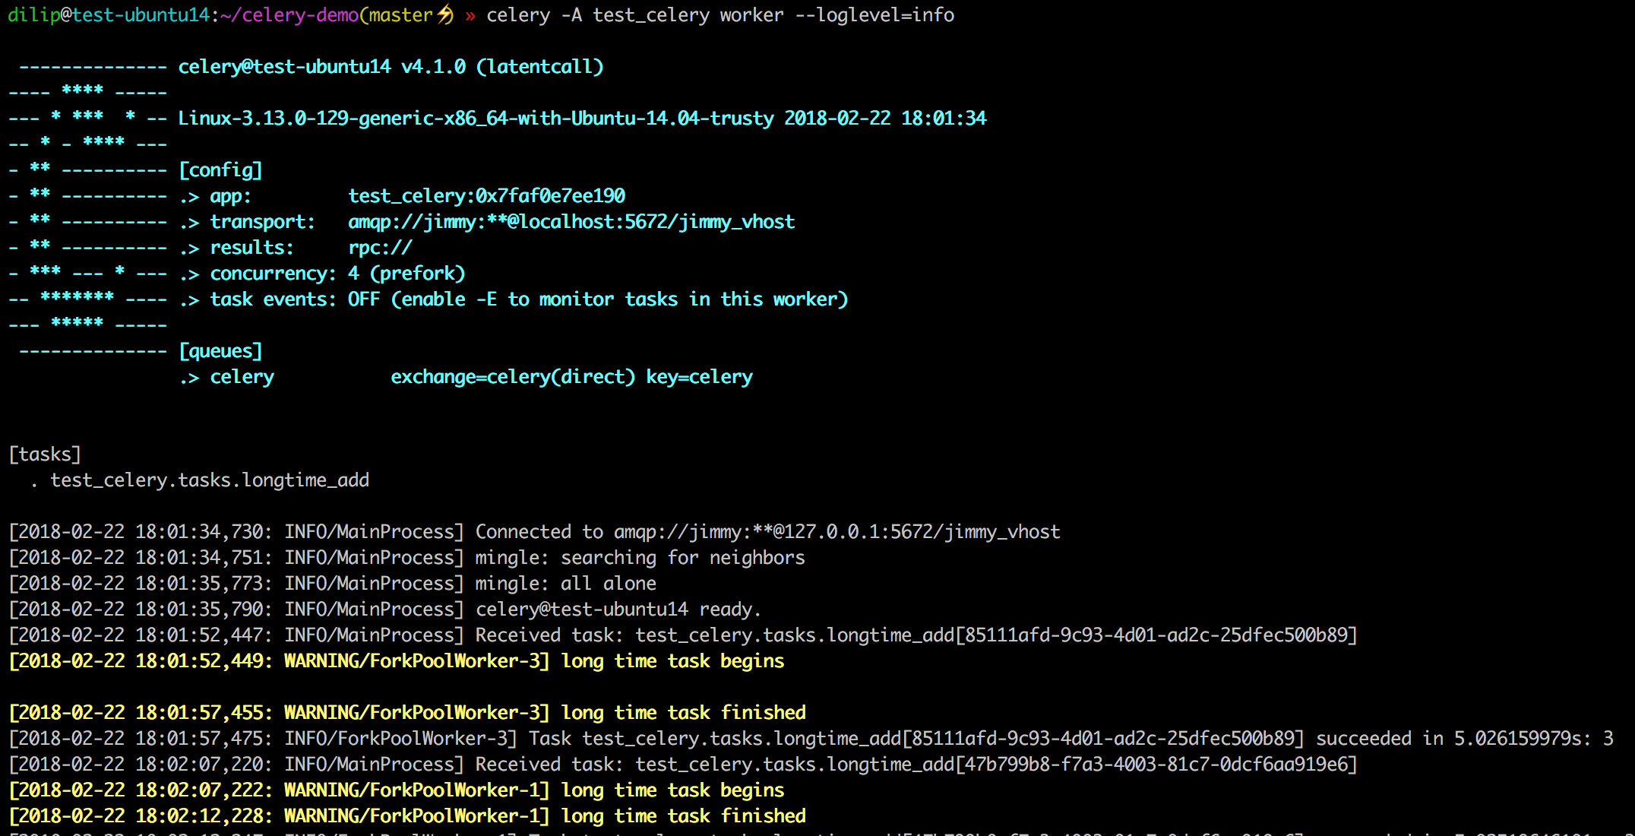
rabbitmq-Celery demo task for scaling workers
Notes:
Dilip

Slide 11
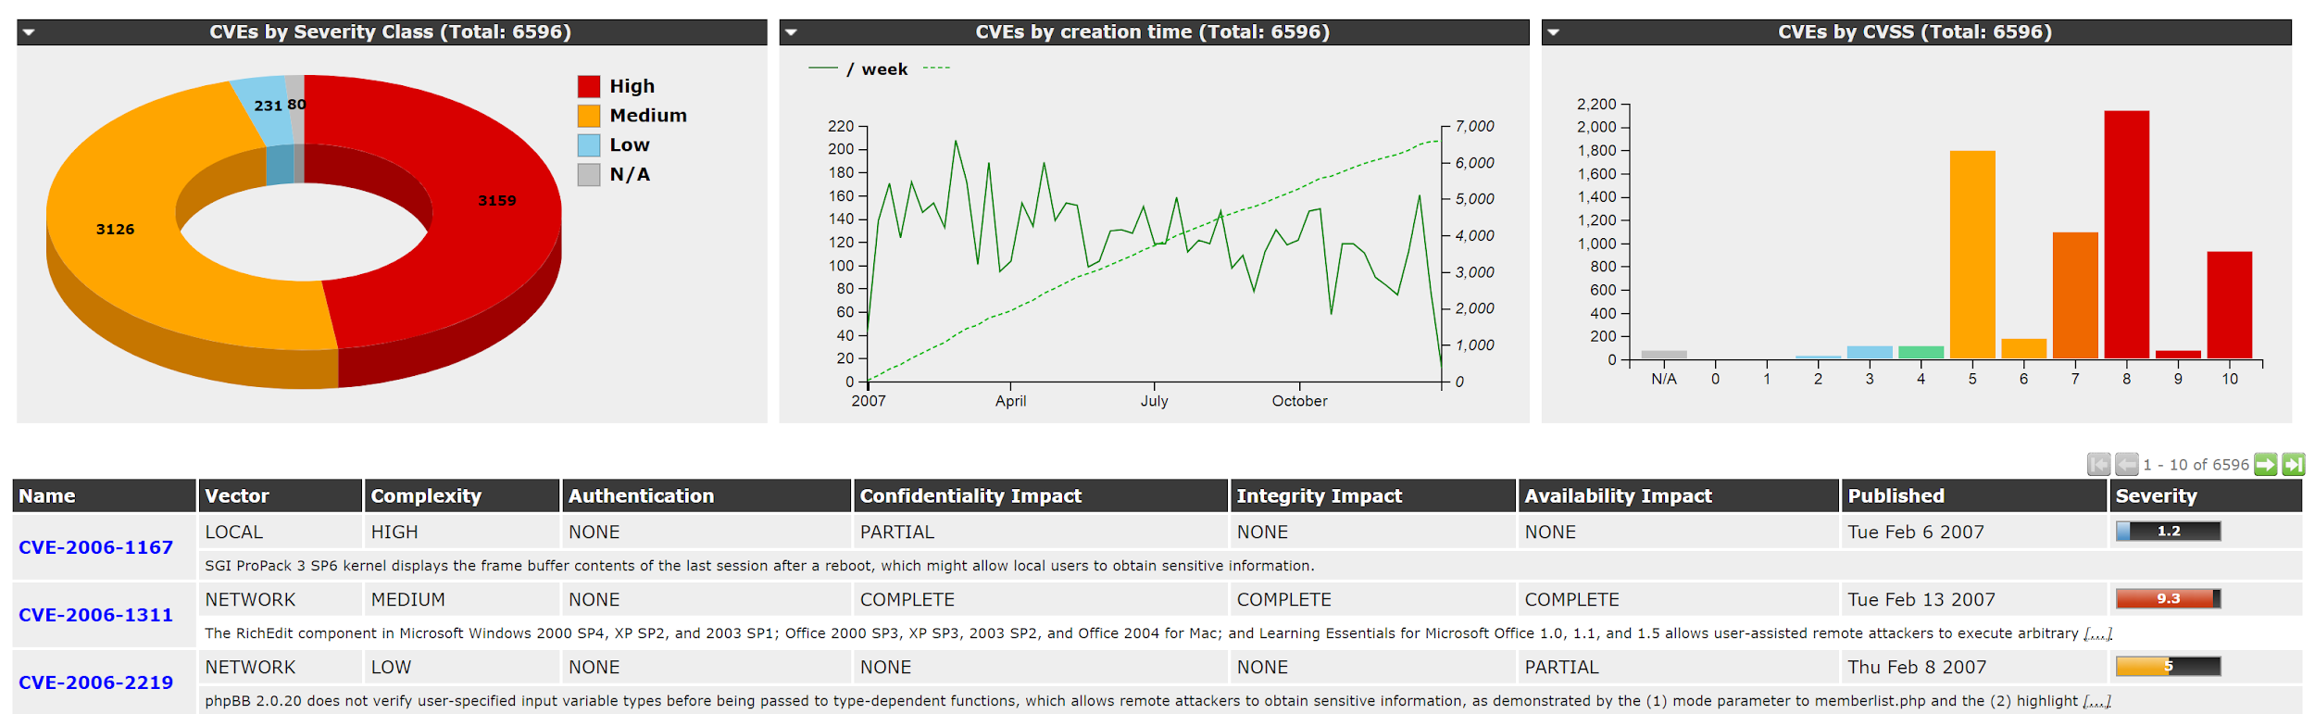
Next steps- Sprint 4
Improve results: include more information to more closely match “live” image scanners, e.g. OpenVAS:
Scaling up:
containers vs processes- implement both and benchmark

Slide 12
Extended Release Schedule
Sprint 5
Implement the chosen scaling solution (container or multi-processing)
Sprint 6
Design, implement and test RESTful API
Integrate into Trilio tools (including running on a “real” POC system)
“Nice-to-have” feature: Generate a user friendly report based on the scanning result (data visualization)
Sprint 7
Testing

